Slide 1
ENSE 471, Milestone 1
Yumi
Clark Inocalla
Jinkai Fan
Zain Abedin
February 6, 2019

Slide 2
Prep & review stage
Discuss the Engineering sites your team reviewed
• University of Regina
• University of British Columbia
• University of Saskatchewan
Discuss data from stakeholder perspectives that you used
• Staff members wants easier accessibility like reducing the amount of clicks to get in to forms.
• Trevor wants the website to be dynamic and projects to be shared in social medias (e.g. Facebook).

Slide 3

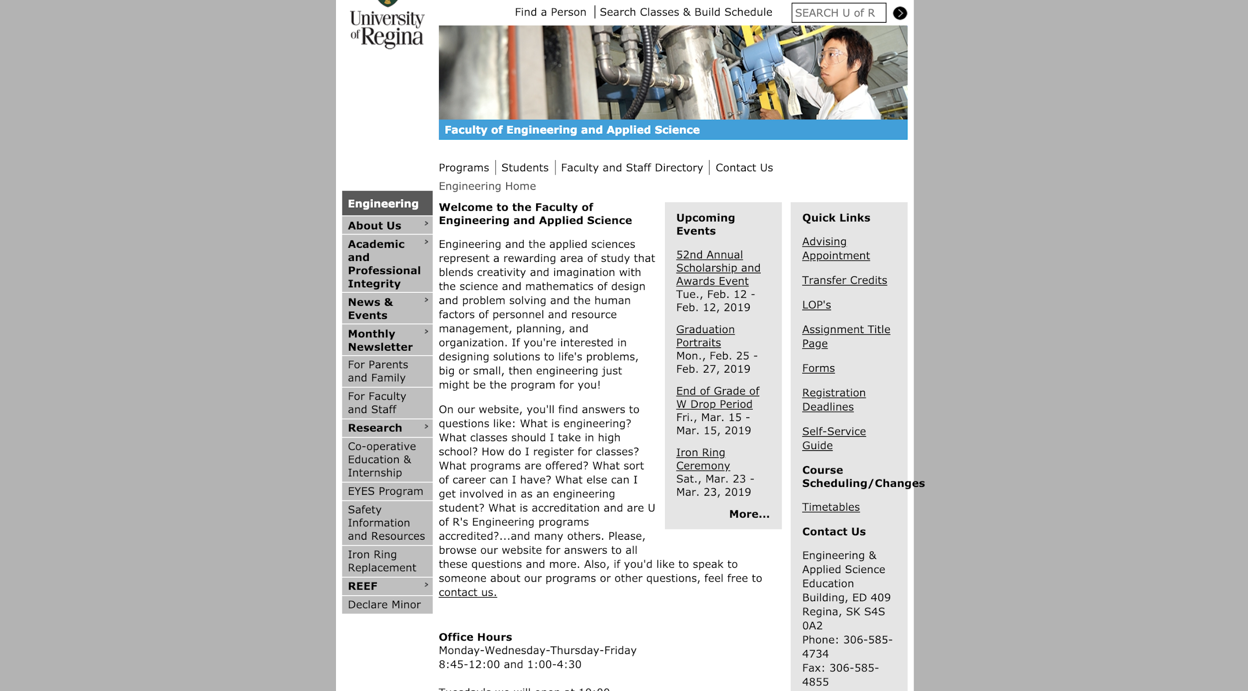
Current student
Office hours and Quick links are helpful
Mobile not friendly
Future student
No “how to apply” and
“requriement”
Public
It is good to have social media

Slide 4
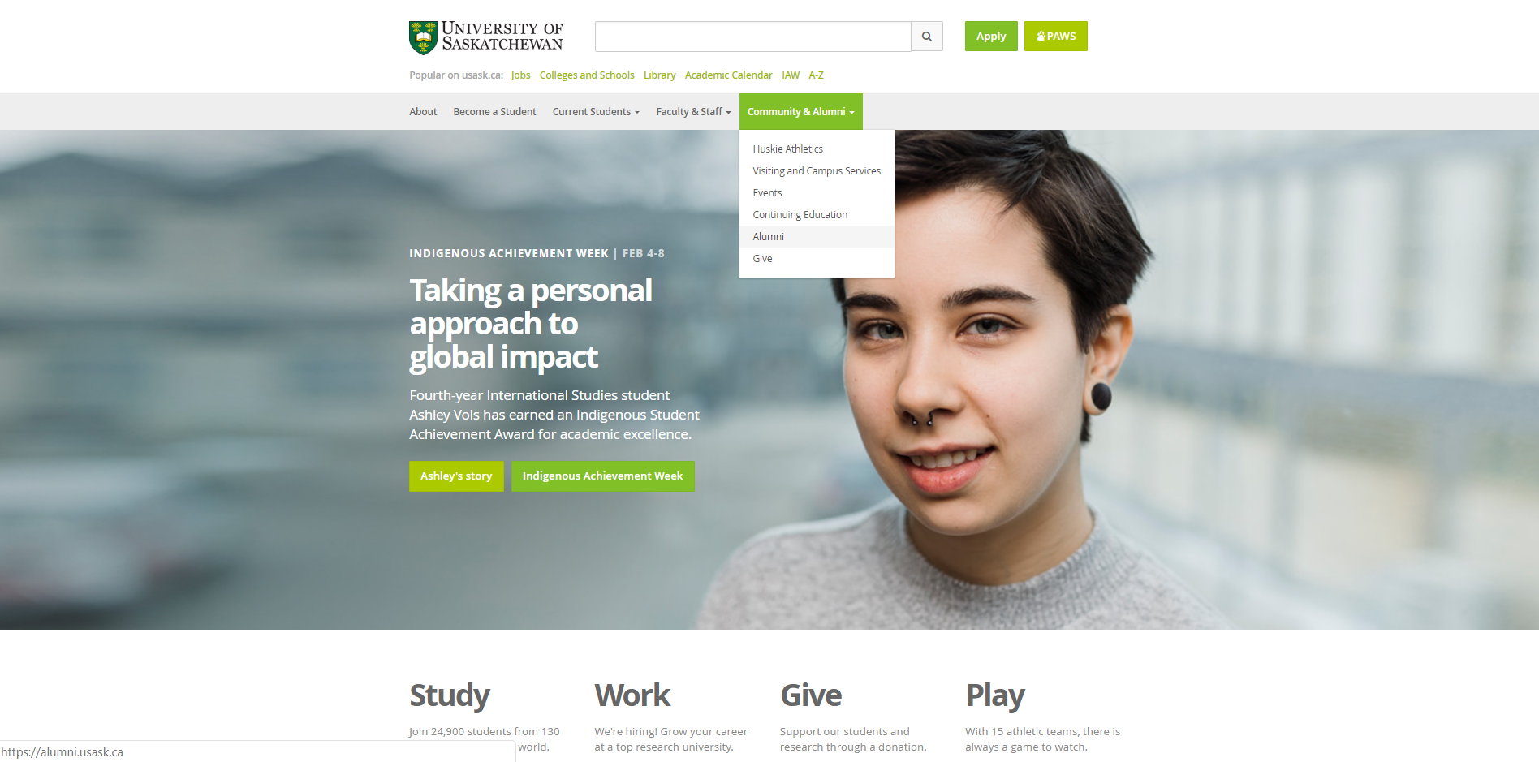
University of Saskatechwan
Current student
Easy access to student services and course information from navigation
Future student
Easy access to program list and course catalogue
Difficult to navigate between programs(no search filter)
Public
Access to visiting services and about page from the main navigation
Access to social meda links
Mobile friendly

Slide 5

University of British Columba
Meets user needs and wants
Due to its good design user is able to navigate and find what they’re looking for with ease.
Compared to UofR I like the way website looks and feel.

Slide 6
Overall (data gathered from all customer perspectives for all sites)
 | Liked | Disliked
University of Regina | Simple&Clean Easy to use | Dead links Ugly
University of British Columbia | Good information architecture | Opens new tab when looking at the gallery
University of Saskatchewan | consistent page layouts easy accessibility | No search filter

Slide 7
Target customers & observe stage
•Discuss the target customers your team focusing on
Current student
Future student
Parents

Slide 8
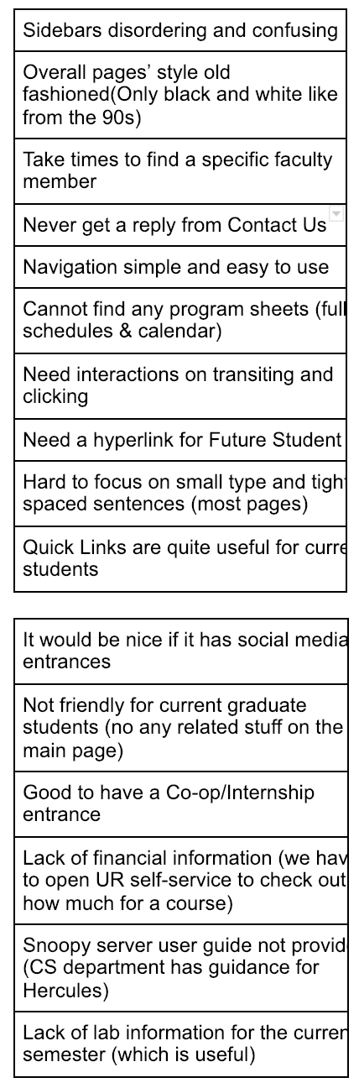
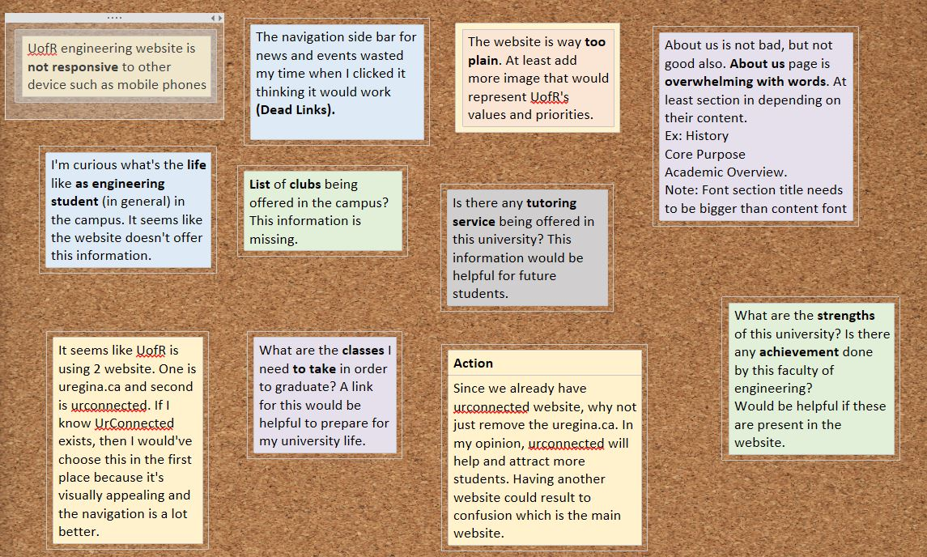
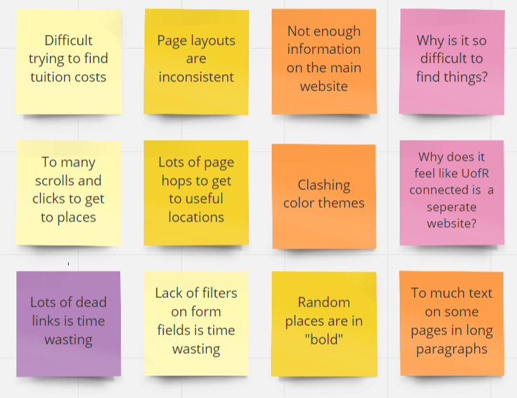
Use screen shots/documentation collected to illustrate stages
Step 0.) Put individual user quotes, ideas, needs, actions (etc.) on separate pieces of paper/sticky notes.

Slide 9
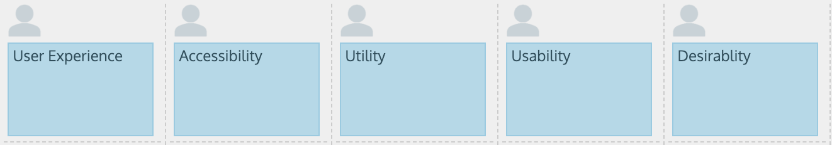
Use screen shots/documentation collected to illustrate stages
Step 1, Initial sorting: As a team, sort and group similar quotes, ideas, needs, actions (etc.). Let the data guide the categories/groups. Don't stress too much at this stage as you will resort again

Slide 10
Use screen shots/documentation collected to illustrate stages
Step 2, Summarize: As a team, summarize and theme each pile
Step 3, Read-out/Re-sort: As a team, go through each pile and make additional notes, re-theme, summaries
Step 4, Tape it up: As a team, once you are satisfied with the groupings, collect the groupings and make them visual, e.g. tape up the groupings on a wall
Step 5, Look for insights: Make note of the size of each category (may indicate higher user needs/design focus), are there similar categories? are there themes across groupings? etc.

Slide 11
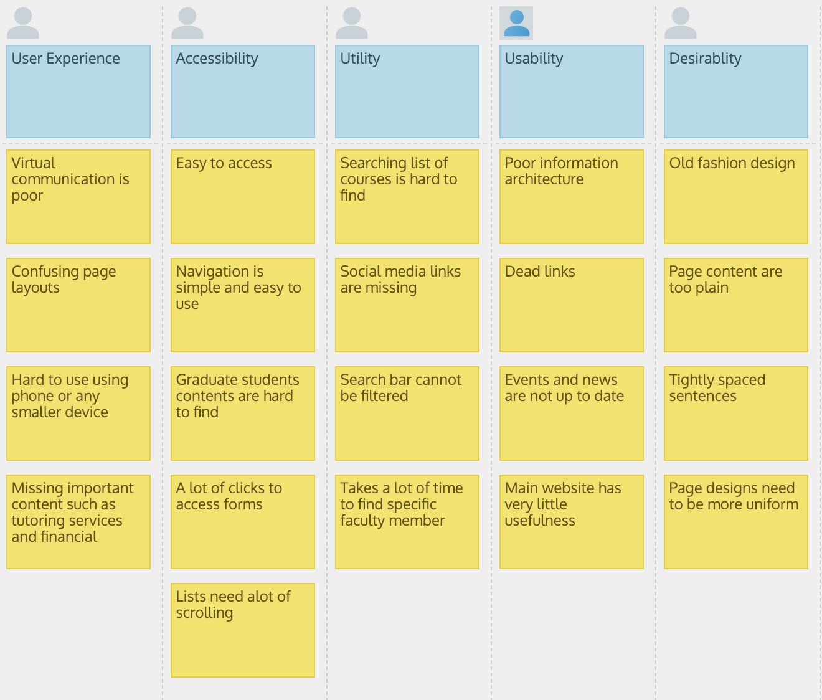
Affinity Diagram

Slide 12
Frame stage
•Demonstrate your team’s user story map
https://landofooo.storiesonboard.com/m2/yumi
•Emphasize key scenarios (epics, user stories) that you will focus on for your team’s MVPs
•Highlight your team’s first MVP
•Why were these experiences deemed critical to the first MVP?

Slide 13
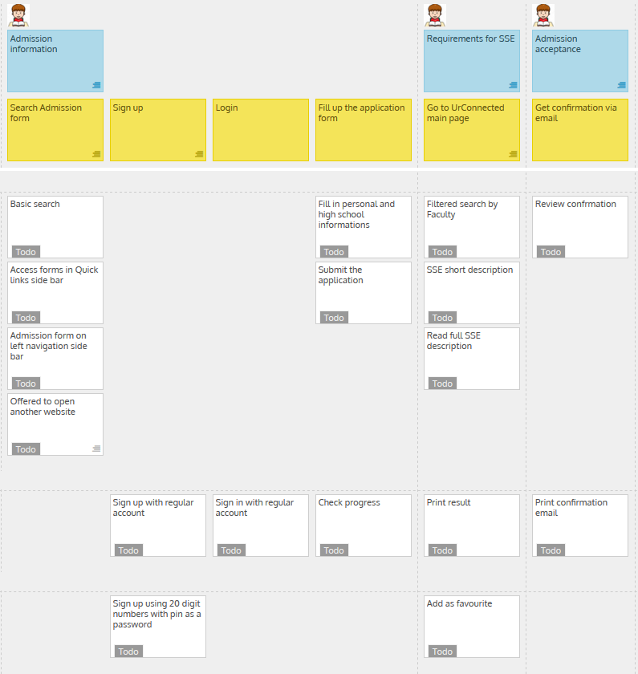
Future Student MVP

Slide 14
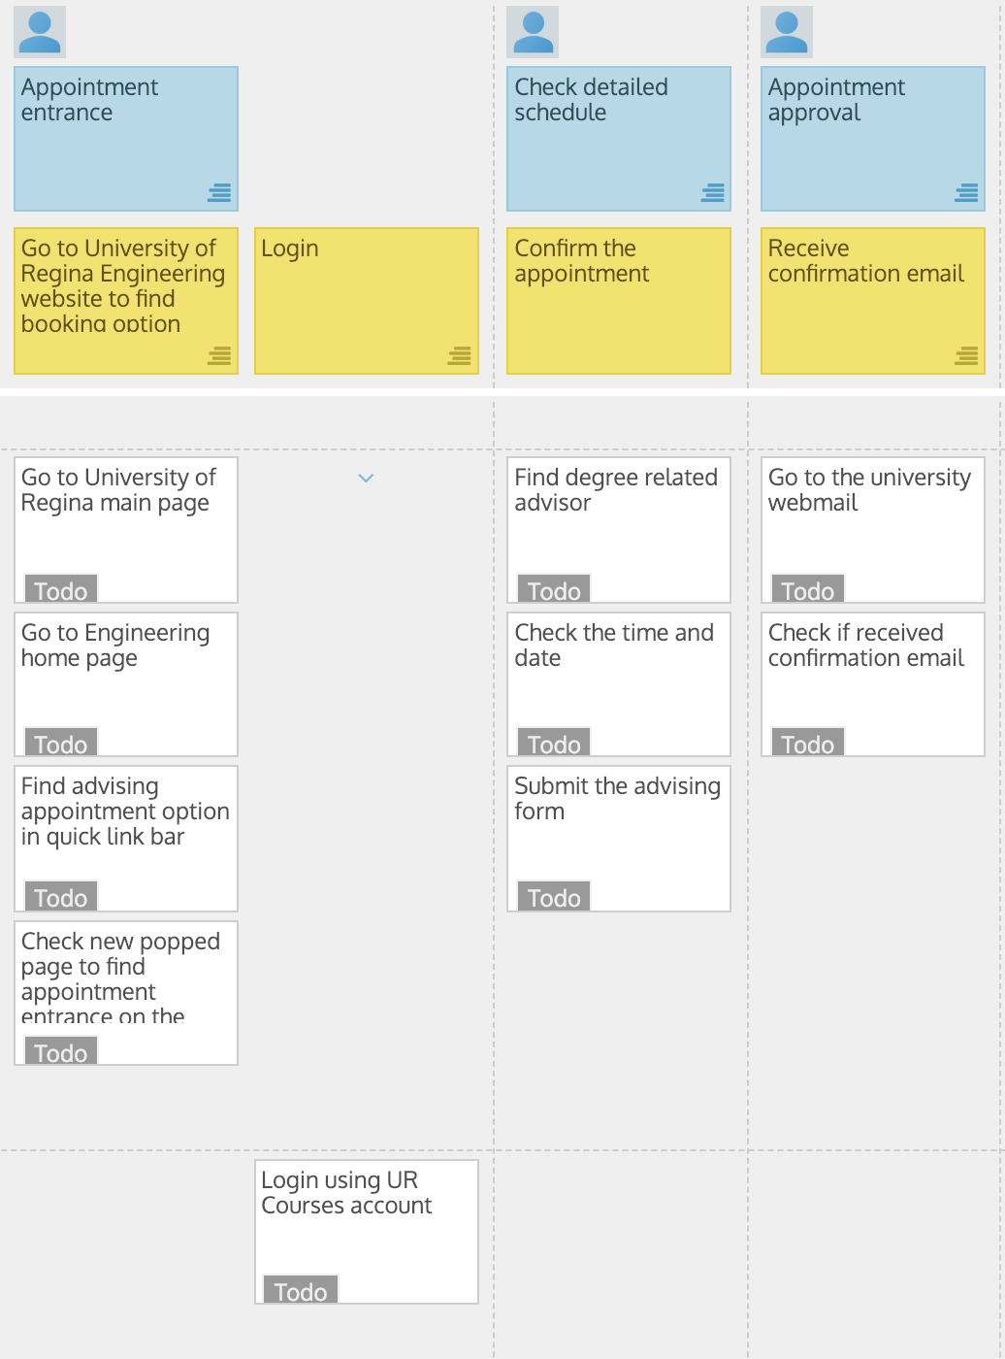
Current Students MVP

Slide 15
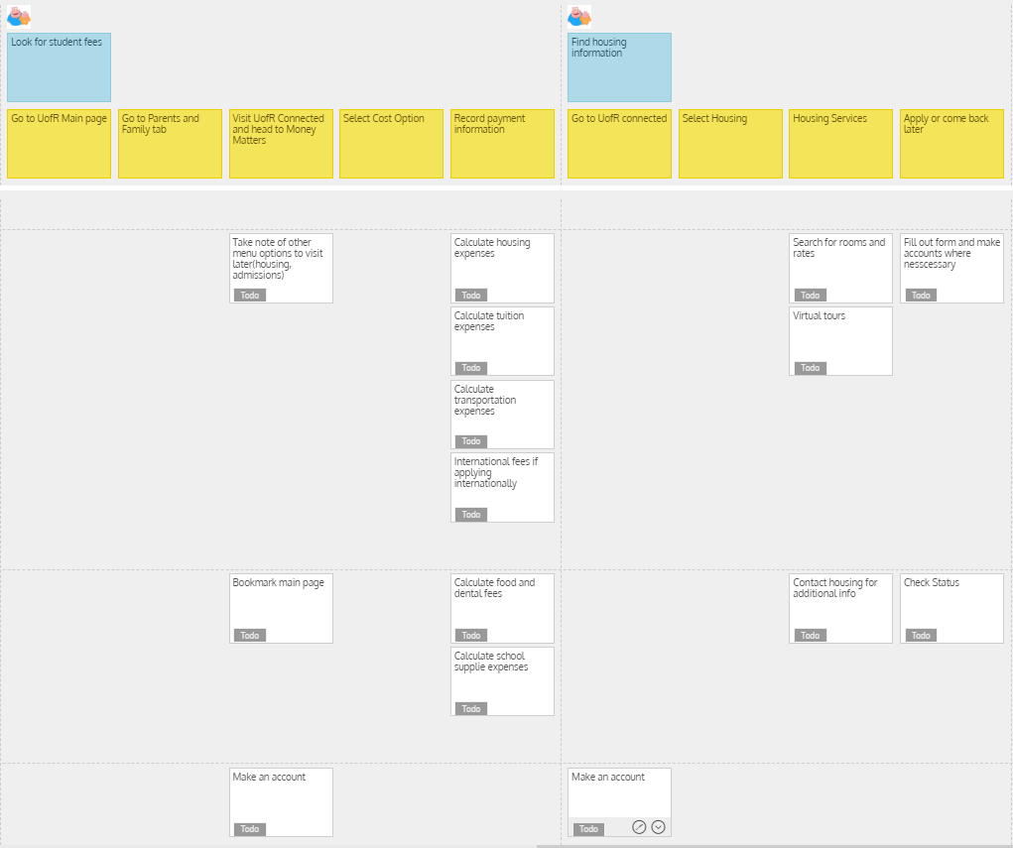
Parents

Slide 16
GitHub review
•Show your Team’s GitHub
https://github.com/Yomi471
•Discuss its structure and flow
•Ensure to illustrate that all Milestone 1 files are uploaded, e.g.
•Prep and review documentation
•Observe documentation (affinity diagram, etc.)
•Frame documentation (USM snapshot, etc.)
•Does your team provide the “stamp of approval” for uploaded content and GitHub structure usability/readability (discoverability and understandability)?
No, we did not.

Slide 17
Group reflection
•How did you feel about this milestone? What did you like about it? What did you dislike?
Milestone was good.
•What did you learn about yourself as you collaborated and worked through this milestone?
We learned how to work more fluently as a team, like assign reasonable tasks to each member.
•How will you use what you have learned going forward?
Brainstorm and plan things ahead of time
•What “stuff & things” related to this milestone would you want help with?
More clarification on what is expected to be done.
It would be better if Trevor and Tim could explain more details on the milestone. Sometimes it confuses people.

